Slide 1

Politecnico di Milano
A.A. 2015-2016
Software Engineering 2 project: MyTaxiService
Design Document
Alessandro Pozzi (matr. 852358), Marco Romani (matr. 852361)

Slide 2
Overview
Different users communicating over the internet with a single system
Client-Server three-tier Architecture
Users can use different platforms (mobile and web)
The system accept user’s requests and elaborate an answer in a short time
Event-based system with Publisher-Subscribe
The system must notify multiple users of the occurring of some events

Slide 3
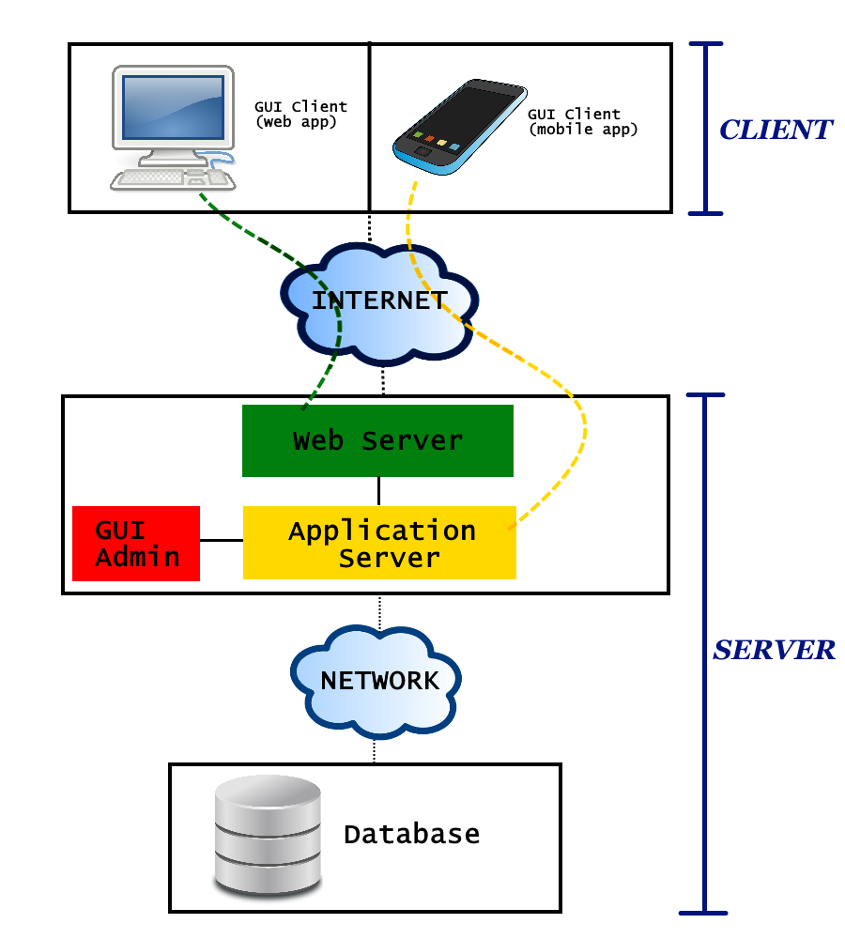
Three tier architecture
Top tier (Client)
The users’ machines (mobile phones and computers) will have the only purpose to load the Graphical User Interface (GUI)
No application logic is involved at this level
Clients will only be able to send requests to the web server and application server.

Slide 4
Three tier architecture
Middle tier
Web Server
Manages the web requests sent by clients using the web application.
If the request can be resolved with a static content page, the web server will generate and send the response itself.
If the request comports a dynamic content, the web server will delegate the dynamic response generation to the application server

Slide 5
Three tier architecture
Middle tier
Application Server
Provides access to the business logic
Provide lightweight APIs to be used directly by mobile application clients
Web application clients will access this component indirectly, through the Web Server.
Admin’s GUI
Specific interface for Administrators
Allows Admins to access to their exclusive functions dialoguing directly with the business logic

Slide 6
Three tier architecture
Bottom tier (Database)
Separated from the previous one with a (possibly local) network
Contains all the data that MyTaxiService needs to store

Slide 7
Event-Based architecture
The core of MTS’s application logic is event-based:
Significant change of state (users modifying theirs account information, drivers changing status, etc)
Event
The system will handle it accordingly
Generates
In particular, the managing of the customer’s requests and taxi rides will be modeled with the publisher-subscribe pattern.

Slide 8
Publish-Subscribe pattern
TOPIC
When customers create a ride request they generate a topic (and automatically subscribe)
When a taxi driver is associated to a ride, he will be subscribed to the same topic too
Subscribers receive their topics’ notifications
MESSAGE BROKER
An intermediary component that performs the queue management and the filtering of the messages
Filter messages based on their content, so that taxi drivers and customers related to the same topic won’t receive necessary the same notification or message

